Slide 1
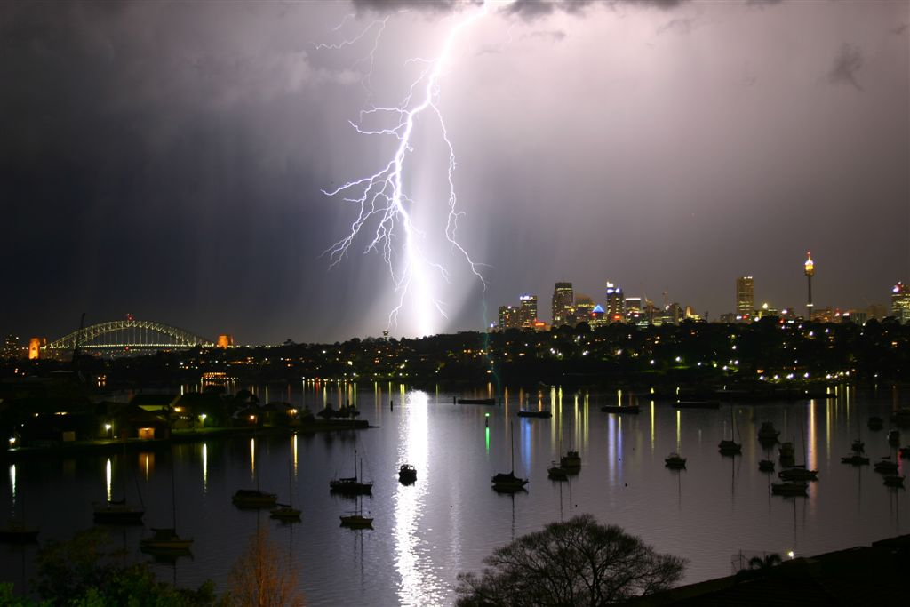
Bouncing Ball Lightning and Theoretical Predictions. John. J. Lowke. CSIRO Manufacturing, Lindfield NSW, Australia

Slide 2
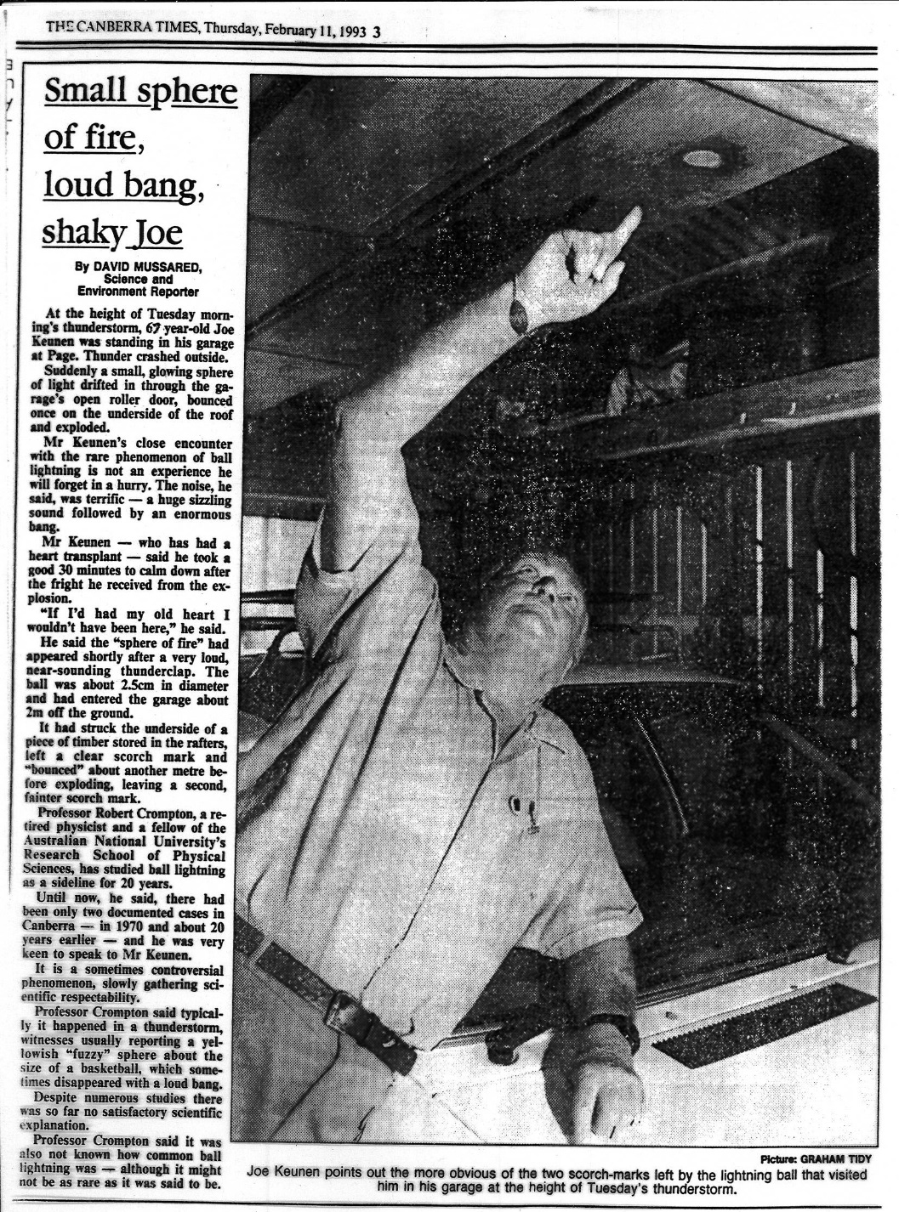
Ball Lightning Observation
Joe Keunan
Canberra, Australia, 1993.

Slide 3
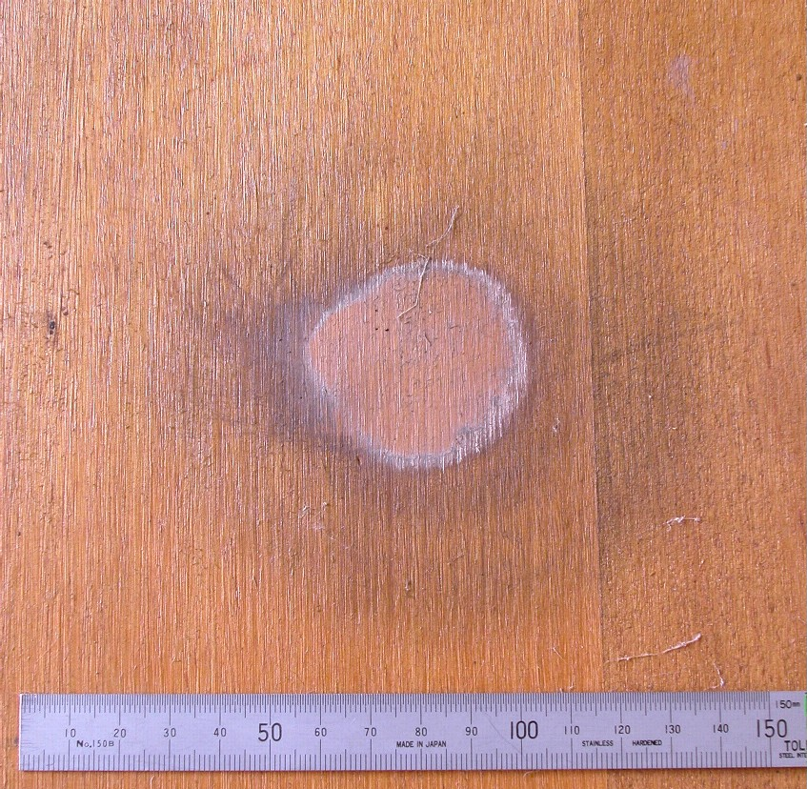
Bounces
First Bounce
Second Impact

Slide 4
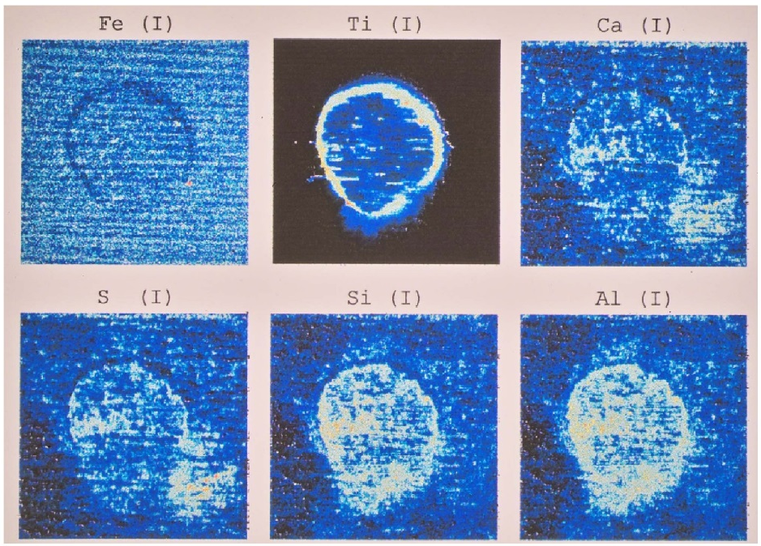
X-Ray Fluorescence Analysis
by Milutin Stoilovic, Forensic Services, Australian Federal Police
Fe Ti Ca
S Si Al

Slide 5
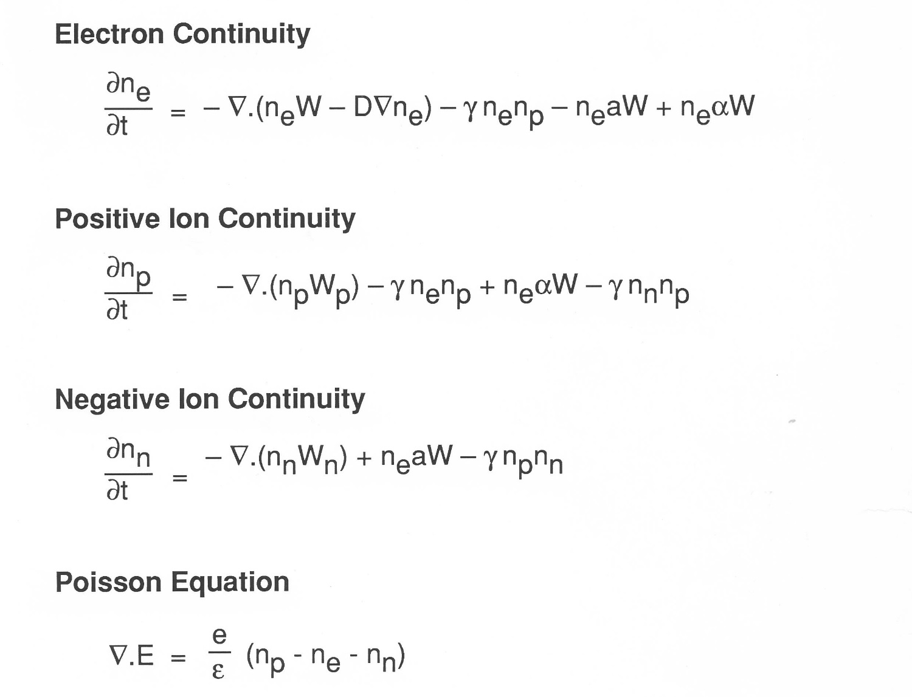
Reactions Ionization e + O₂ → 2e + O₂⁺
Attachment e + O₂ → O₂⁻
Recombination e + O₂⁺ → O₂
Equations

Slide 6
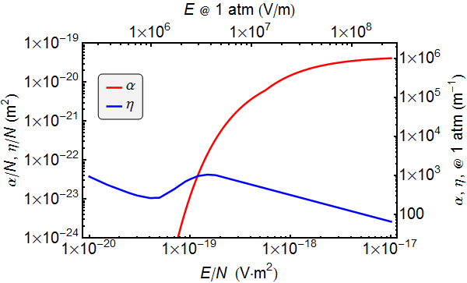
Electron Ionization and Attachment
α is ionization coefficient
η is attachment coefficient

Slide 7
Ball Lightning through windows
Glass
+
+
+
+
+
+
+
-
-
-
-
-
-
-
Ball
Lightning
Net Positive Charge
Positive Ion stream
Background E field
+ + + +
+ + + + +
+ + +
Background E field doubled!
Lowke et al J. Geophys. Res. 117, D19107, 2012

Slide 8
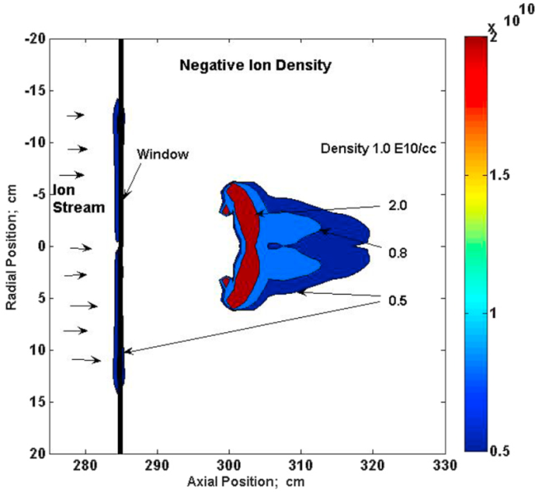
Calculated Discharge on far side of glass
Negative Ion Densities /cc

Slide 9
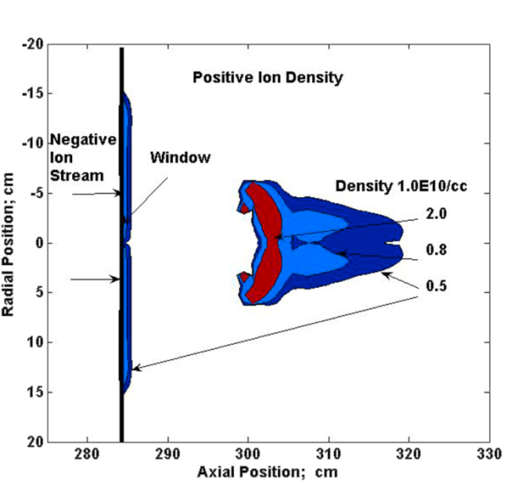
Calculated Discharge on far side of glass
Positive Ion Densities /cc

Slide 10
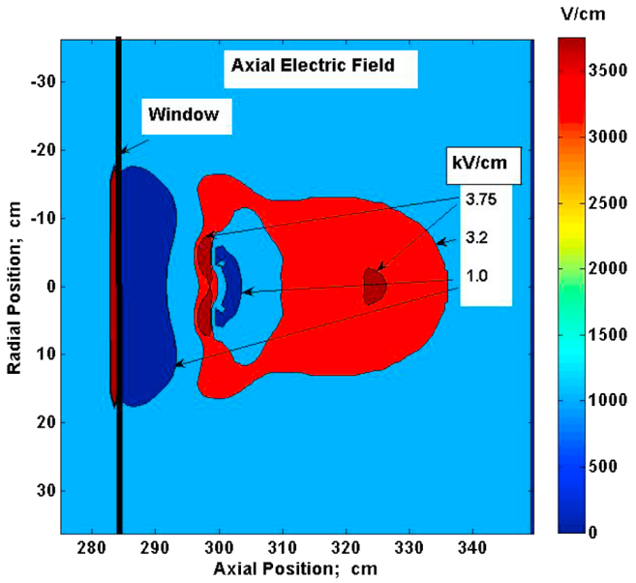
Calculated Electric Field
First Pulse

Slide 11
Calculated Electric Fields
First three pulses

Slide 12
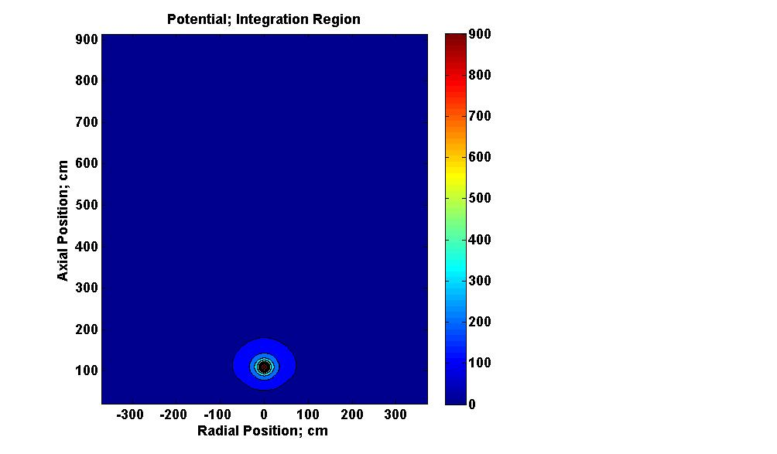
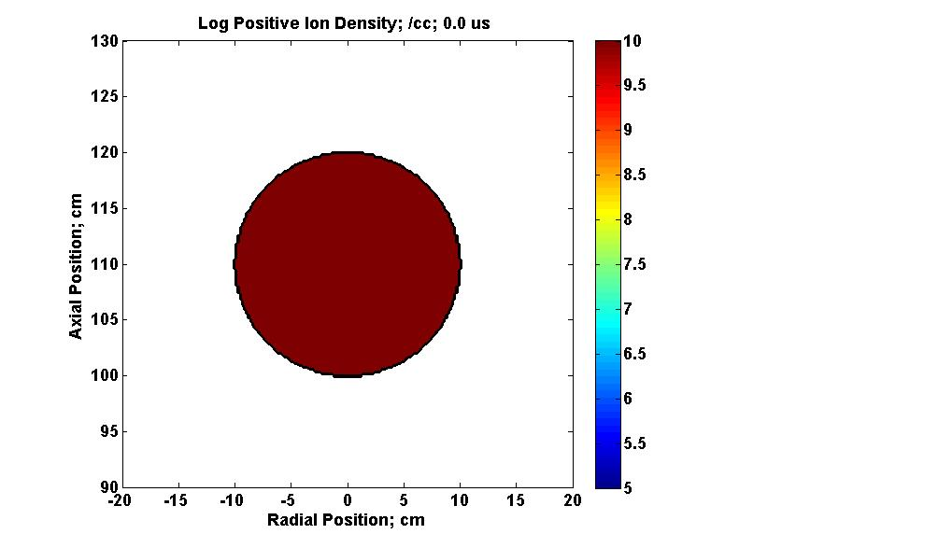
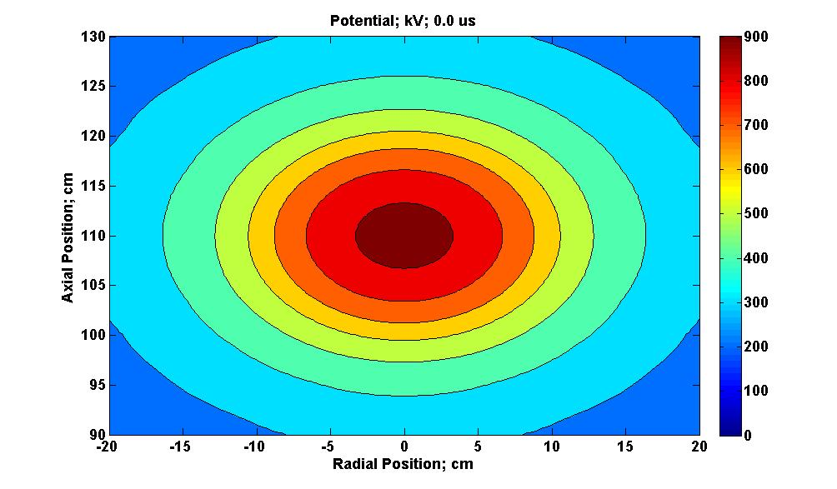
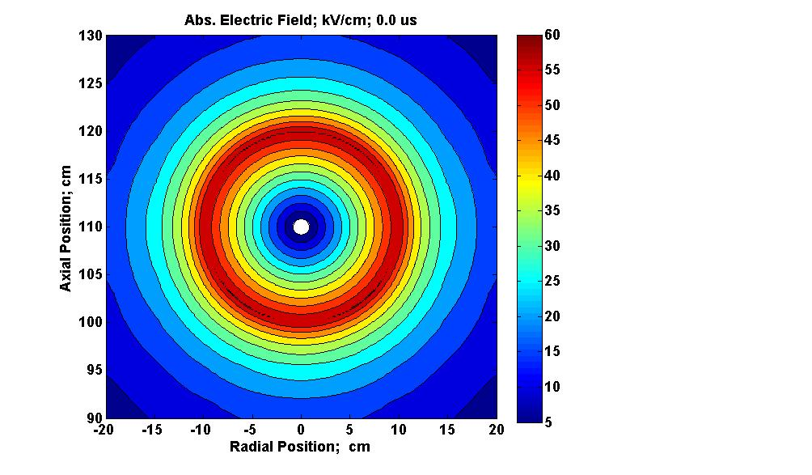

Slide 13
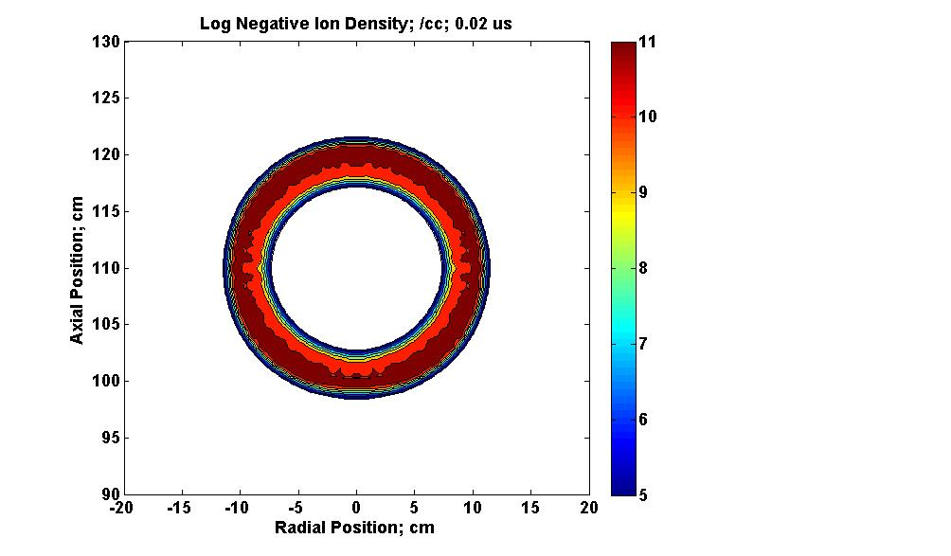

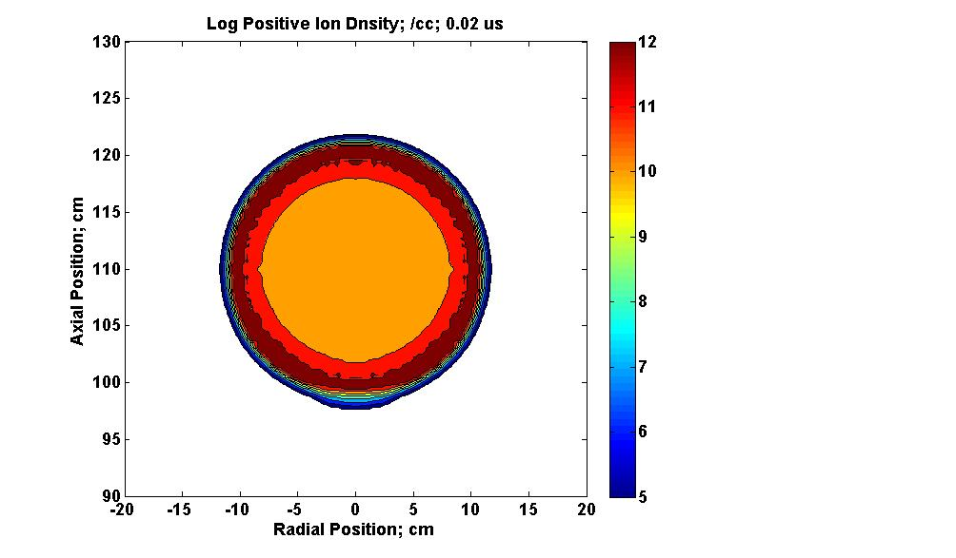
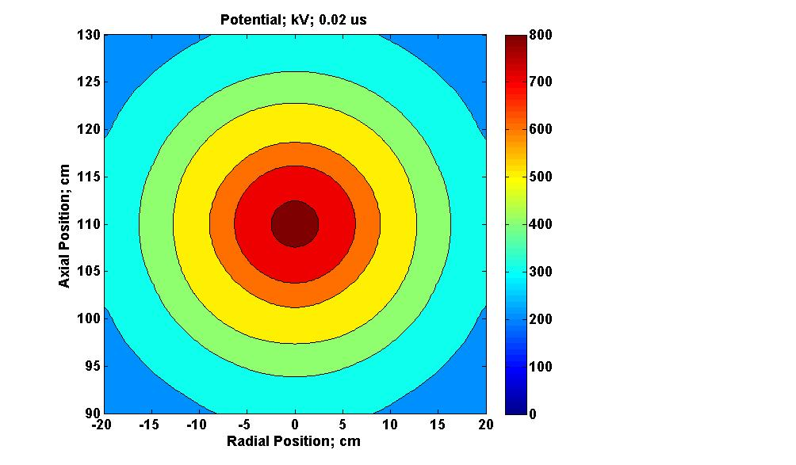

Slide 14
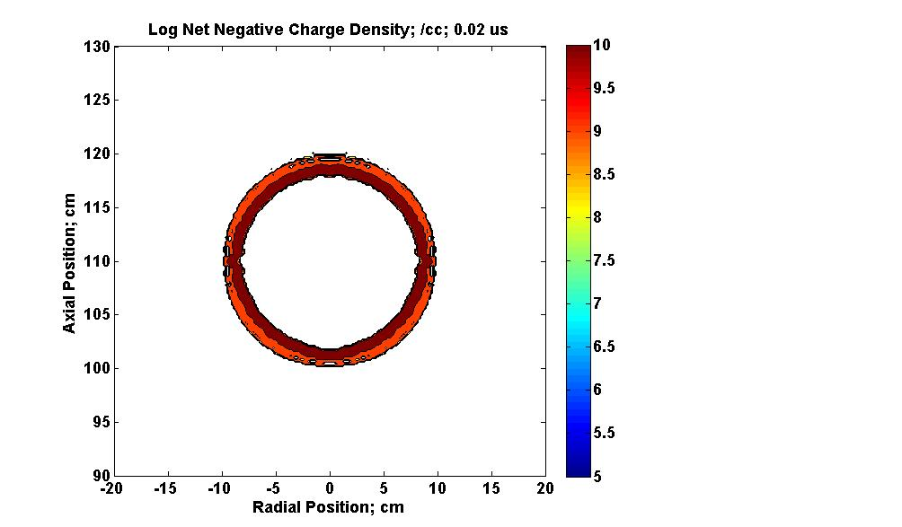
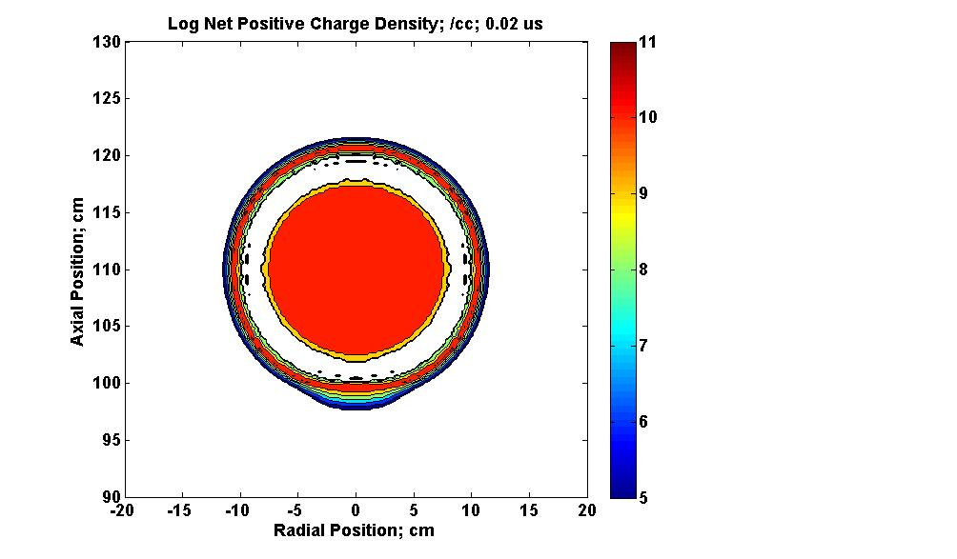
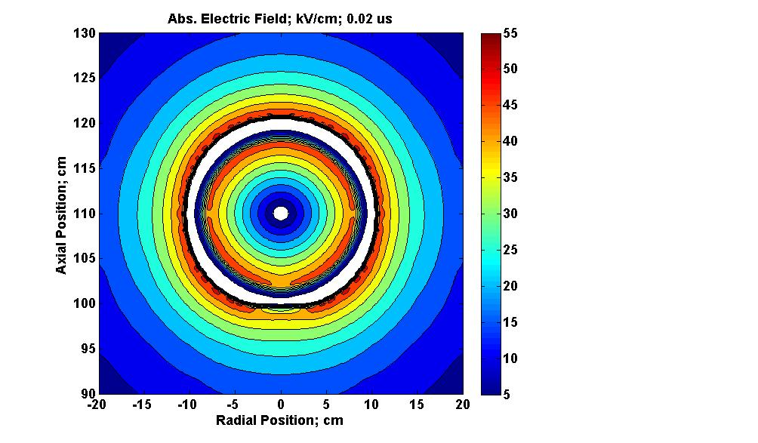

Slide 15
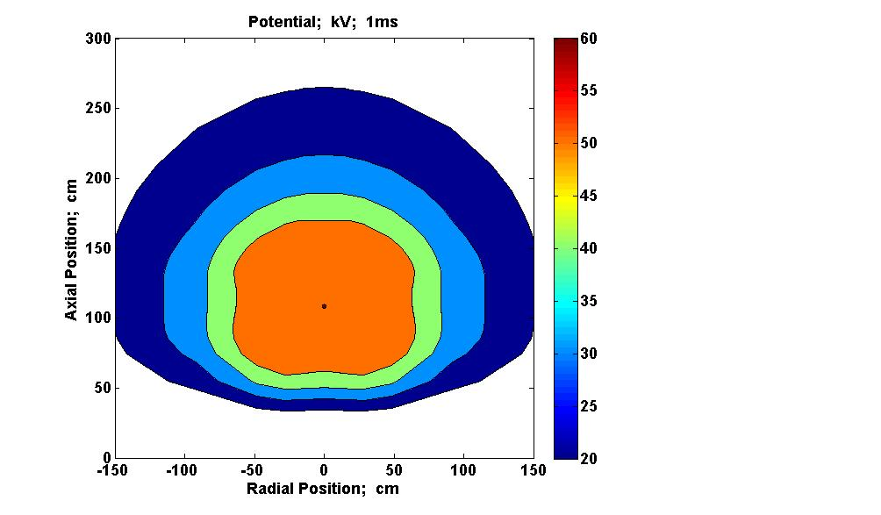
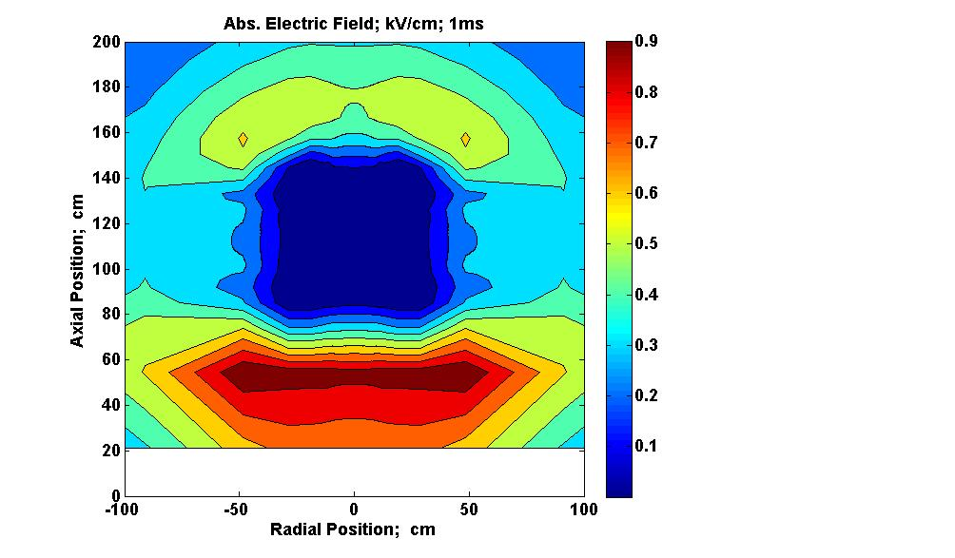
Potential and Electric Field after 1 ms.

Slide 16
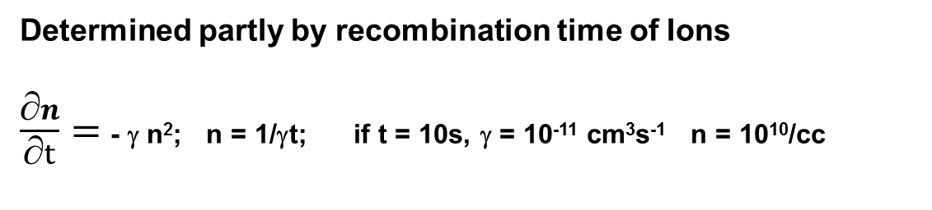
Energy
Ball Lightning 2 % 100 W Incandescent light for 10 s = 20 J
Ball, Radius 10 cm, ion density 3×10¹⁰ /cc = QV/2 = 45 J
( Q = 30μC, V = 3 MV)
Lifetime
Determined partly by recombination time of Ions
$\frac{∂n}{∂t}=$ - γ n²; n = 1/γt; if t = 10s, γ = 10⁻¹¹ cm³s⁻¹ n = 10¹⁰/cc

Slide 17
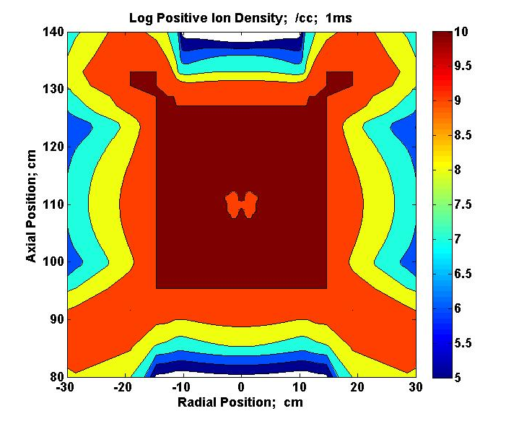
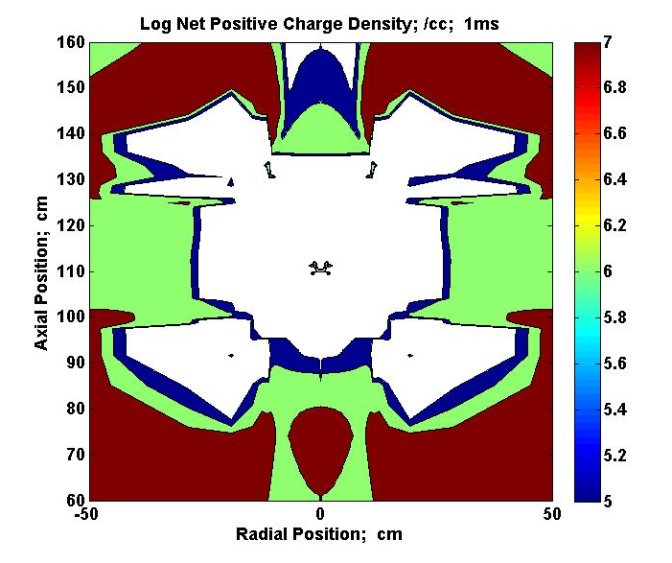
Log Charge Densities after 1 ms

Slide 18
Amplification of background Field
by a Cylinder
Thunder Cloud
At Point P, potential is zero
V = q/4πεR - E₀h = 0
E = q/4πεR² after substituting for q
= E₀h/R !
Background field E₀
P
Charge q
Applies for
Sizes from aircraft to needles
Insulators
Unearthed aircraft in sky
Height h
Radius R
18 |
Presentation title | Presenter name

